Slide 1

Optimizing Delivery Routes With Quantum Algorithms
by
B Arjun Dev
Roll No. 234G5A3202
N Naga Chaitanya
Roll No. 224G1A3294
R Suraiah Khaisar
Roll No. 224G1A3298
P Venkatanaveen
Roll No. 2244G1A32B1
Under the guidance of
Mr. K Venkatesh _{M. Tech., (Ph.D)}
Assistant Professor
Department of Computer Science and Engineering (Data Science)
Srinivasa Ramanujan Institute of Technology
Autonomous
Rotarypuram Village, B K Samudram Mandal, Ananthapuramu – 515701.
2025-2026

Slide 2
Review – 0 Comments
What you will do when you choose an alternate path that consumes more fuel as you mentioned your system generates alternate paths when it faces and obstacle?
What is the difference between the existing solution and your approach or solution as similar system exist?
DEPT. OF COMPUTER SCIENCE ENGINEERING(DATA SCIENCE)

Slide 3
Review – 1 Comments
What exact parameters are used in your cost function, and how do you balance fuel cost, distance, travel time, and delivery deadlines?
What method is used to prioritize on-time delivery over cost or distance when conflicts arise?
DEPT. OF COMPUTER SCIENCE ENGINEERING(DATA SCIENCE)

Slide 4
Abstract
This project presents a hybrid quantum–classical approach for optimizing delivery routes in dynamic environments. Traditional routing systems typically generate a single optimal route, which becomes unreliable when traffic congestion or roadblocks occur. To overcome this limitation, the proposed system generates multiple feasible delivery routes using classical heuristics and selects the optimal route using a quantum optimization algorithm. Customers are first clustered to reduce problem complexity, and candidate routes are filtered for feasibility before quantum execution. The Quantum Approximate Optimization Algorithm (QAOA) is applied to select efficient routes while maintaining stability through penalty normalization and multi-start execution. A simulation environment demonstrates continuous vehicle movement from a warehouse to customer destinations and dynamically switches to alternate routes when obstacles appear. The results show improved robustness, scalability, and adaptability compared to conventional single-route delivery systems.
DEPT. OF COMPUTER SCIENCE ENGINEERING(DATA SCIENCE)

Slide 5
Problem Statement
Traditional delivery routing systems generate only a single optimal route, which becomes unreliable in real-world conditions such as traffic congestion, roadblocks, or delays. Existing quantum and classical approaches also struggle with scalability, stability, and often produce incomplete solutions. Therefore, there is a need for a robust delivery routing system that can generate multiple feasible and efficient routes, ensuring timely deliveries and adaptability by switching to alternate routes when disruptions occur.
DEPT. OF COMPUTER SCIENCE ENGINEERING(DATA SCIENCE)

Slide 6
Objectives
To Develop a Scalable Hybrid Quantum–Classical Routing Framework: To design a hybrid quantum–classical routing framework using clustering and QAOA to optimize large delivery networks efficiently on near-term quantum hardware.
To Generate Multiple Optimized and Alternate Delivery Routes: To generate a primary route and multiple alternate routes using heuristic and quantum optimization for quick adaptation to traffic and route disruptions.
To Improve Solution Stability and Reliability through Automated Optimization: To improve solution reliability through automated penalty tuning, feasibility filtering, and repair mechanisms, ensuring consistent and feasible routing results.
DEPT. OF COMPUTER SCIENCE ENGINEERING(DATA SCIENCE)

Slide 7
Literature survey
Paper | Method Used | Key Finding | Research Gap
QAOA for VRP [1] | QUBO + QAOA | Works for small routes | Poor scalability
Quantum Annealing VRPTW [2] | D-Wave + repair | Cost minimized | Needs heavy repair
Hybrid Decomposition [3] | Problem splitting | Better scalability | No dynamic routing
Q4RPD Framework [4] | Hybrid QA + classical | Handles constraints | No route switching
Real-World QA Routing [5] | Quantum annealing | Feasible small cases | No execution demo
Transport Optimization [6] | Hybrid QC analysis | QC helps small cases | Hardware limits
Classical Routing [7] | Heuristic methods | Efficient static routing | No backup routes
DEPT. OF COMPUTER SCIENCE ENGINEERING(DATA SCIENCE)

Slide 8
Proposed Work
The proposed system follows a hybrid quantum–classical optimization framework to improve delivery routing performance.
Scalable Clustering & Preprocessing: Large delivery networks are divided into small quantum-manageable clusters, and infeasible routes are filtered using classical methods.
Multi-Route Generation: Multiple primary and alternate routes are generated using multi-start heuristics to ensure backup paths during disruptions.
Quantum Optimization with Auto-Tuning: Routes are formulated as QUBO models and optimized using multi-start QAOA with automatic penalty tuning for stable performance.
Hybrid Execution & Dynamic Switching: Classical and quantum components are coordinated to execute routes and instantly switch to alternate paths during traffic or obstacles.
DEPT. OF COMPUTER SCIENCE ENGINEERING(DATA SCIENCE)

Slide 9
Introduction
Delivery route optimization is an important problem in logistics and transportation systems
It focuses on finding efficient routes from a warehouse to multiple customers
Efficient routing helps reduce travel time, fuel consumption, and delivery cost
Traditional routing systems usually generate only one optimal route
Real-world conditions like traffic congestion and roadblocks can disrupt this route
Quantum computing provides new techniques to explore multiple route possibilities
This project studies how quantum algorithms can assist delivery route optimization
Example:
A delivery vehicle travels from a warehouse to 5 customers
If one road is blocked, a single-route system fails
A multi-route system can quickly switch to an alternate path
DEPT. OF COMPUTER SCIENCE ENGINEERING(DATA SCIENCE)

Slide 10
Existing System
Most delivery systems use classical optimization algorithms
Routes are selected based on shortest distance or fastest time
Only one primary route is generated for delivery
Real-world apps (Google Maps, Amazon, Swiggy, Zomato, Uber Eats):
Provide a single optimized route
Re-route only after traffic or delays occur
Quantum research using D-Wave and IBM Quantum (QAOA):
Works only for small delivery networks
Produces unstable or incomplete routes
Needs classical repair and validation
No system provides pre-computed alternate routes
Current solutions are reactive, not proactive
DEPT. OF COMPUTER SCIENCE ENGINEERING(DATA SCIENCE)

Slide 11
Proposed System
A hybrid quantum–classical routing system that generates optimal and alternate routes for fast switching during traffic or disruptions.
Feature | Existing Solution | Proposed Enhanced Solution
Routing Approach | Classical shortest-path algorithms | Hybrid quantum–classical optimization
Route Generation | Single optimized route | Multiple optimal and alternate routes
Scalability Handling | Limited for large delivery networks | Quantum-manageable customer clustering
Optimization Model | Heuristic or deterministic methods | QUBO-based quantum optimization
Decision Engine | Classical solvers only | QAOA Algorithm
Traffic / Obstacle Handling | Reactive rerouting after delay | Proactive alternate routes available in advance
DEPT. OF COMPUTER SCIENCE ENGINEERING(DATA SCIENCE)

Slide 12
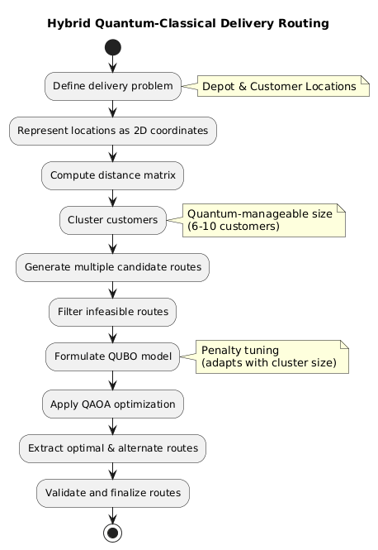
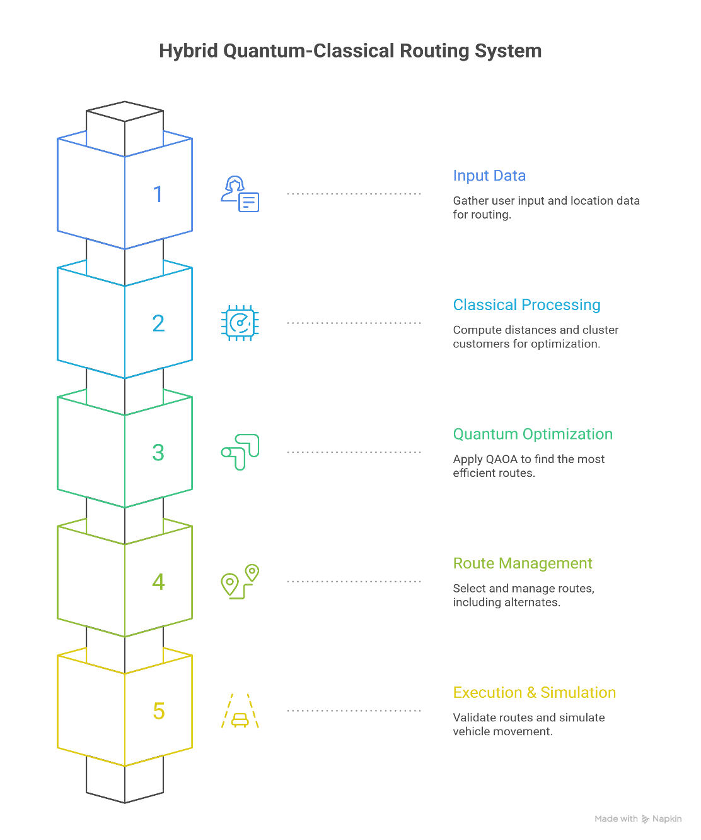
Planning & Design
DEPT. OF COMPUTER SCIENCE ENGINEERING(DATA SCIENCE)

Slide 13
Requirements
Functional Requirements
Accept delivery locations, depot details, and time windows as input
Generate an optimal delivery route using QAOA
Generate multiple alternate routes for each delivery partner
Switch to an alternate route when traffic or delays occur
Validate routes to ensure time and capacity constraints are met
Non-Functional Requirements
Scalability for small to medium delivery networks
Reduced delivery time and fuel consumption
Reliable performance in dynamic conditions
Compatibility with hybrid quantum–classical execution
Stable and robust optimization results
DEPT. OF COMPUTER SCIENCE ENGINEERING(DATA SCIENCE)

Slide 14
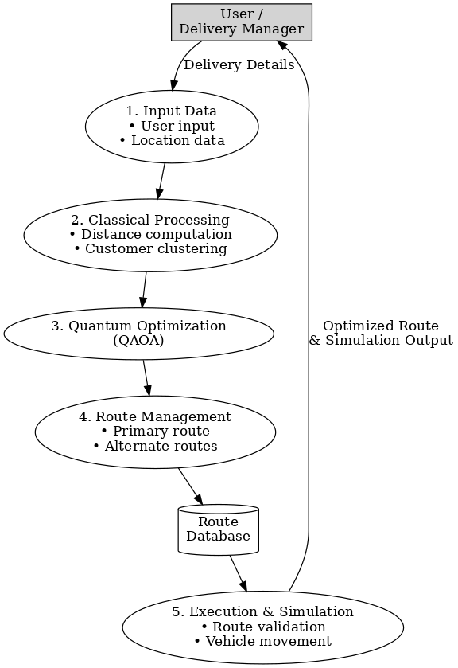
Data Flow Diagram
DEPT. OF COMPUTER SCIENCE ENGINEERING(DATA SCIENCE)

Slide 15
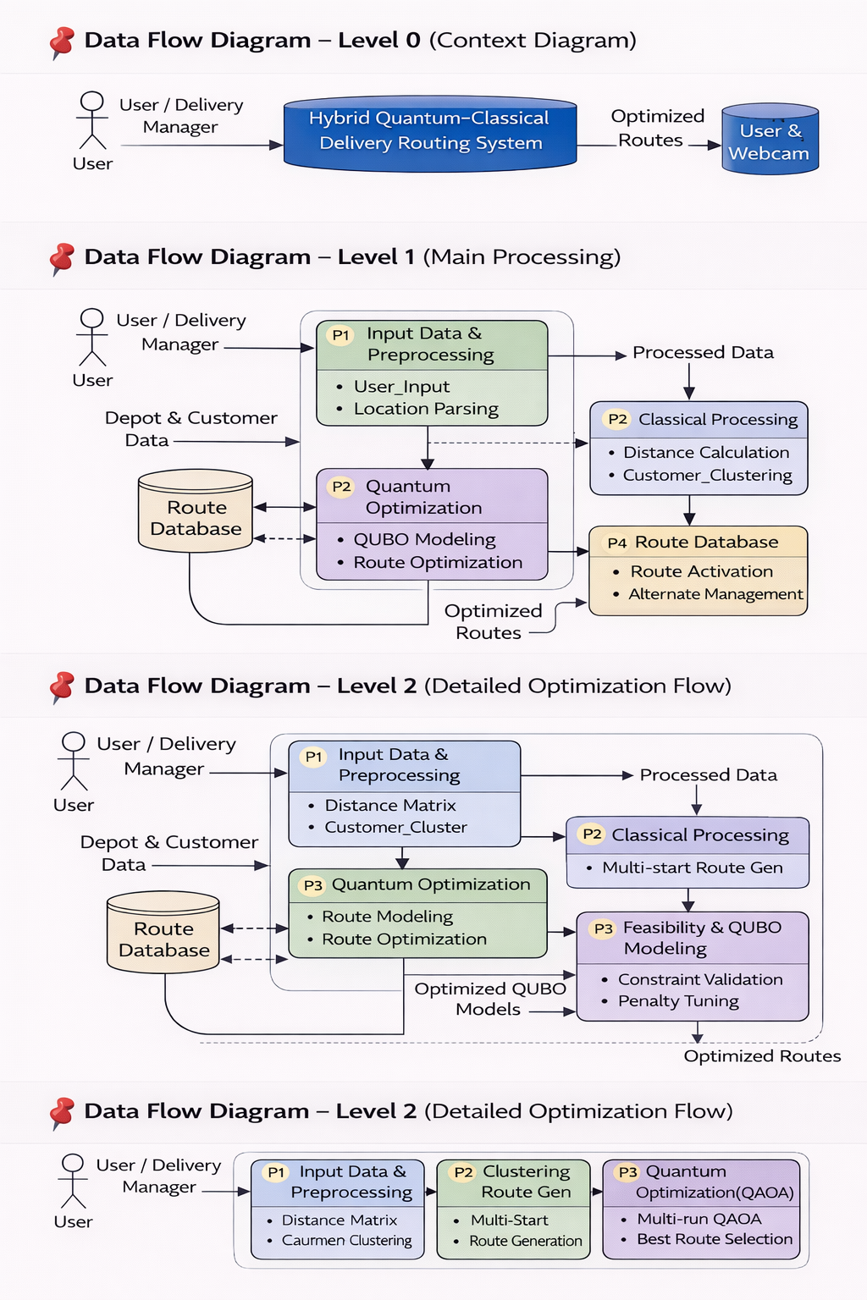
Data Flow Diagram
DEPT. OF COMPUTER SCIENCE ENGINEERING(DATA SCIENCE)

Slide 16
Data Flow Diagram
DEPT. OF COMPUTER SCIENCE ENGINEERING(DATA SCIENCE)

Slide 17
Sample Code
import numpy as np
from sklearn.cluster import KMeans
from qiskit_optimization import QuadraticProgram
from qiskit_optimization.algorithms import MinimumEigenOptimizer
from qiskit_algorithms import QAOA
from qiskit_algorithms.optimizers import COBYLA
from qiskit.primitives import StatevectorEstimator
DEPT. OF COMPUTER SCIENCE ENGINEERING(DATA SCIENCE)

Slide 18
Sample Code
Solve using QAOA
def solve_qaoa(qp):
estimator = StatevectorEstimator()
qaoa = QAOA(estimator, COBYLA(), reps=2)
optimizer = MinimumEigenOptimizer(qaoa)
result = optimizer.solve(qp)
return result
Input:
qp (QUBO problem)
StatevectorEstimator → Simulate quantum circuit
QAOA → Search solution
COBYLA → Tune parameters
MinimumEigenOptimizer → Extract result
Output:
OptimizationResult object
DEPT. OF COMPUTER SCIENCE ENGINEERING(DATA SCIENCE)

Slide 19
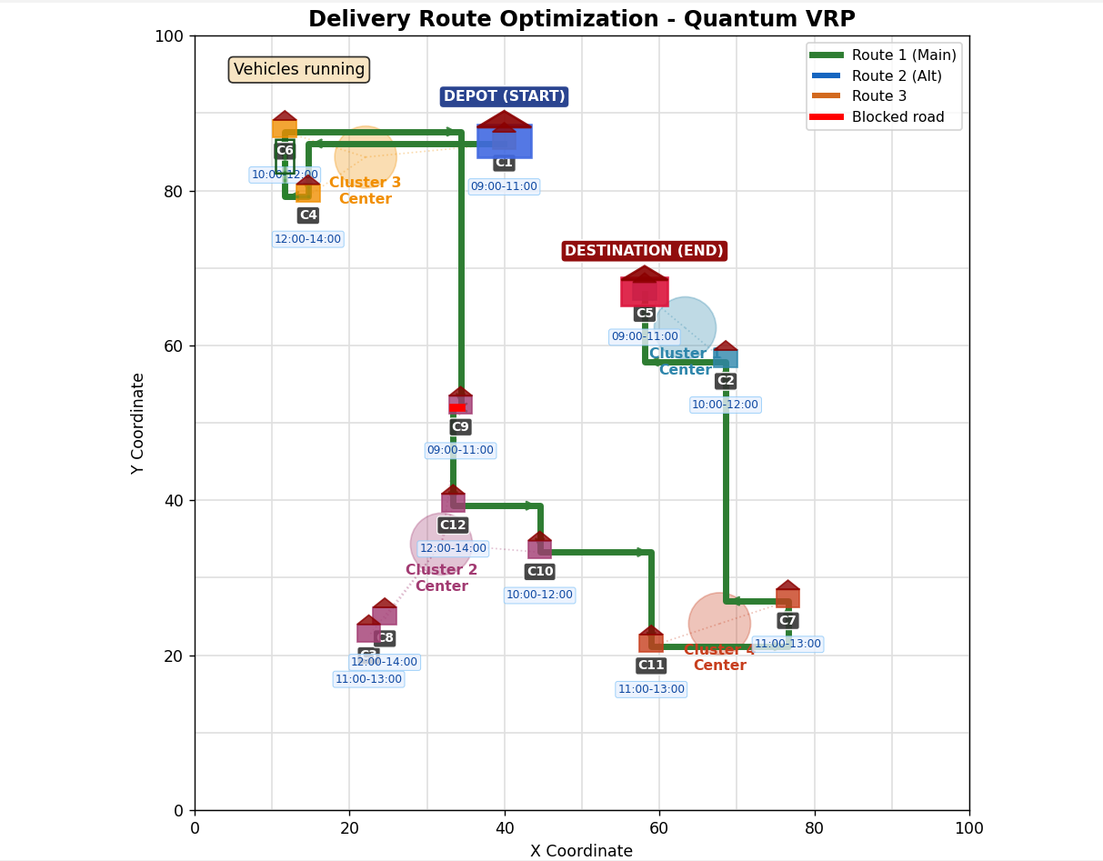
Project Output
DEPT. OF COMPUTER SCIENCE ENGINEERING(DATA SCIENCE)

Slide 20
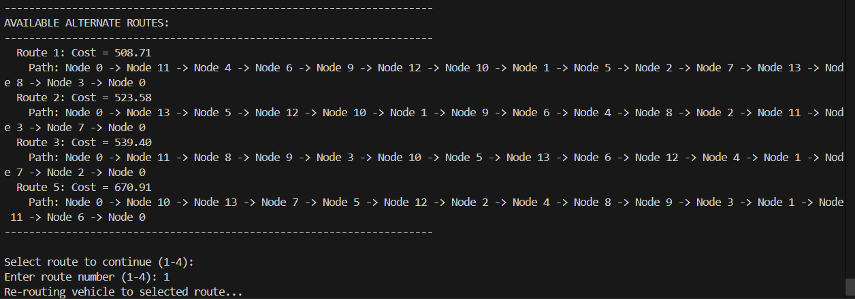
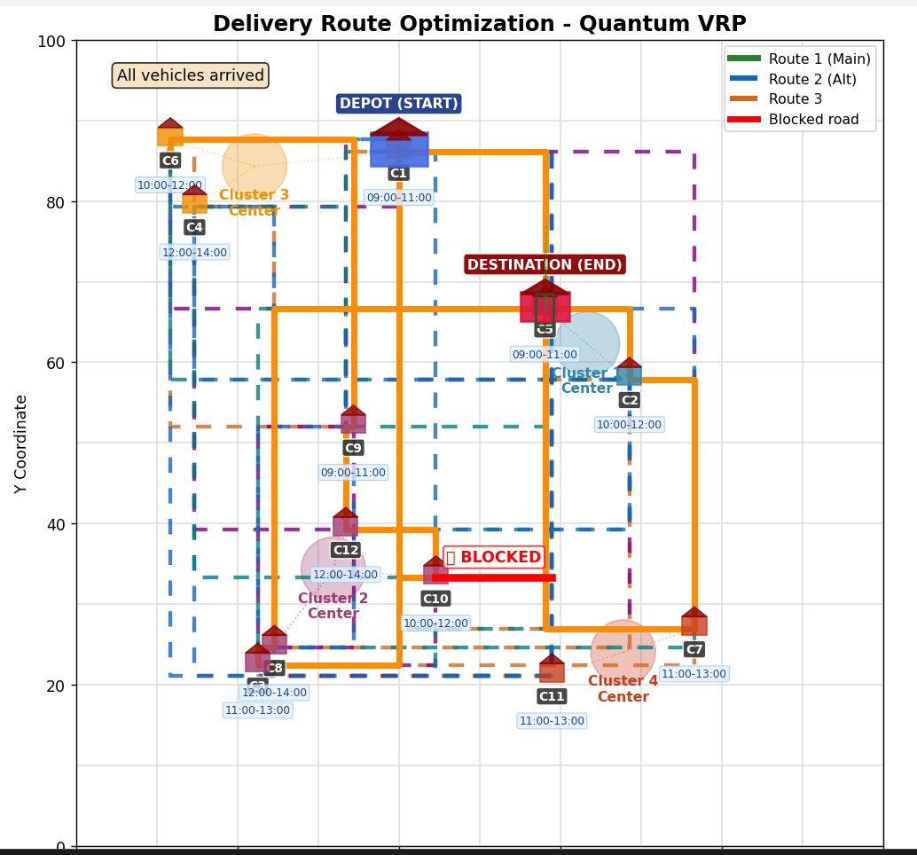
Project Output

Slide 21
References
[1].Talha Azfar, Osama Muhammad Raisuddin, Ruimin Ke, and José Holguín-Veras, “Quantum-Assisted Vehicle Routing: Realizing QAOA-based Approach on Gate-Based Quantum Computer”, Rensselaer Polytechnic Institute, USA.
[2].Eneko Osaba, Esther Villar-Rodriguez, Pablo Miranda-Rodriguez, and Antón Asla, “Optimizing Package Delivery with Quantum Annealers: Addressing Time-Windows and Simultaneous Pickup and Delivery”, arXiv preprint arXiv:2504.01560, Apr. 2025.
[3].James B. Holliday, Darren Blount, Eneko Osaba, and Khoa Luu, “Advanced Quantum Annealing Approach to Vehicle Routing Problems with Time Windows,” arXiv preprint arXiv:2503.24285, Mar. 2025.
[4]. Andrew Maciejunes, John Stenger, Daniel Gunlycke, and Nikos Chrisochoides, “Solving Large-Scale Vehicle Routing Problems with Hybrid Quantum-Classical Decomposition”, in Proceedings of the IEEE International Conference on Quantum Computing and Engineering (QCE), 2025.
DEPT. OF COMPUTER SCIENCE ENGINEERING(DATA SCIENCE)

Slide 22
References
[5].Eneko Osaba, Esther Villar-Rodriguez, and Antón Asla,““Solving a Real-World Package Delivery Routing Problem Using Quantum Annealers,” Scientific Reports, vol. 14, Article no. 24791, 2024.
[6].Utkarsh Azad, Bikash K. Behera, Emad A. Ahmed, Prasanta K. Panigrahi, and Ahmed Farouk,“Solving Vehicle Routing Problem Using Quantum Approximate Optimization Algorithm”, IEEE Transactions on Intelligent Transportation Systems, vol. 24, no. 7, pp. 7564–7576, Jul. 2023.
[7].Christopher D. B. Bentley, Samuel Marsh, André R. R. Carvalho, Philip Kilby, and Michael J. Biercuk,“Quantum Computing for Transport Optimization”, Transport Reviews, vol. 42, no. 4, pp. 1–24, 2022.
DEPT. OF COMPUTER SCIENCE ENGINEERING(DATA SCIENCE)

Slide 23
Thank You!!!
DEPT. OF COMPUTER SCIENCE ENGINEERING(DATA SCIENCE)

